Slide 1
Twitter and LinkedIn
Getting Started With Social Media

Slide 2
Agenda
Why You Can’t Ignore Social Media
The Steps: Optimize, Network, and Engage
Twitter
Conquer Social Media in 20 Minutes
Resources
Questions
LinkedIn
Notes:
http://www.slideshare.net/ennoconn/health-care-social-media-influencers/7

Slide 3
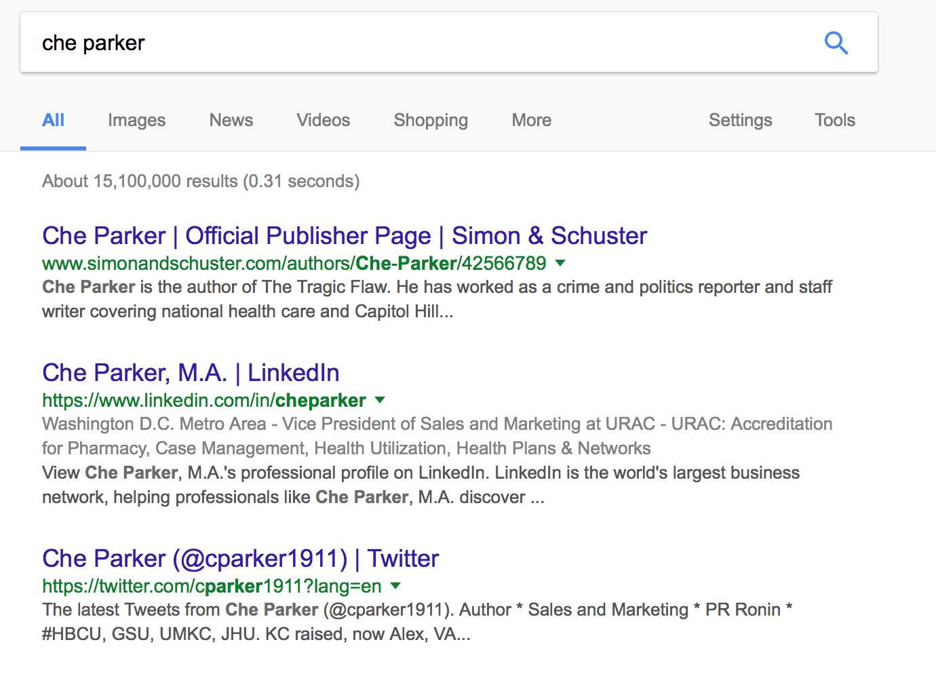
Why can’t you ignore social media? Google yourself.
Google rankings are the best way to boost your authority.
Social profiles often shape the first thing someone learns about you.
Notes:
Karen read statistics
But to see why you should be on social media, you must Google yourself.

Slide 4

Key steps:
Optimize
Network
Engage
Follow these steps and your influence will grow.

Slide 5

Twitter

Slide 6

What is Twitter?
Twitter is a platform wherein users share thoughts, news, information in 140 characters of text or less.
Key terms:
Tweet: A 140-character message
Retweet (RT): Re-sharing a tweet
Feed: The stream of tweets you see on your homepage
Handle: Your username
Mention (@): A way to reference another user
Direct Message (DM): A private message
Hashtag (#): A way to denote a topic

Slide 7
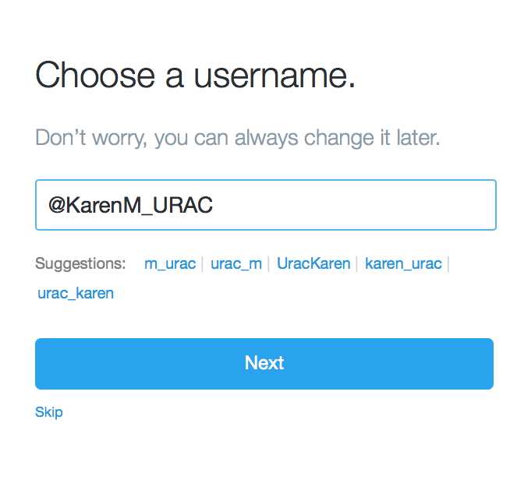
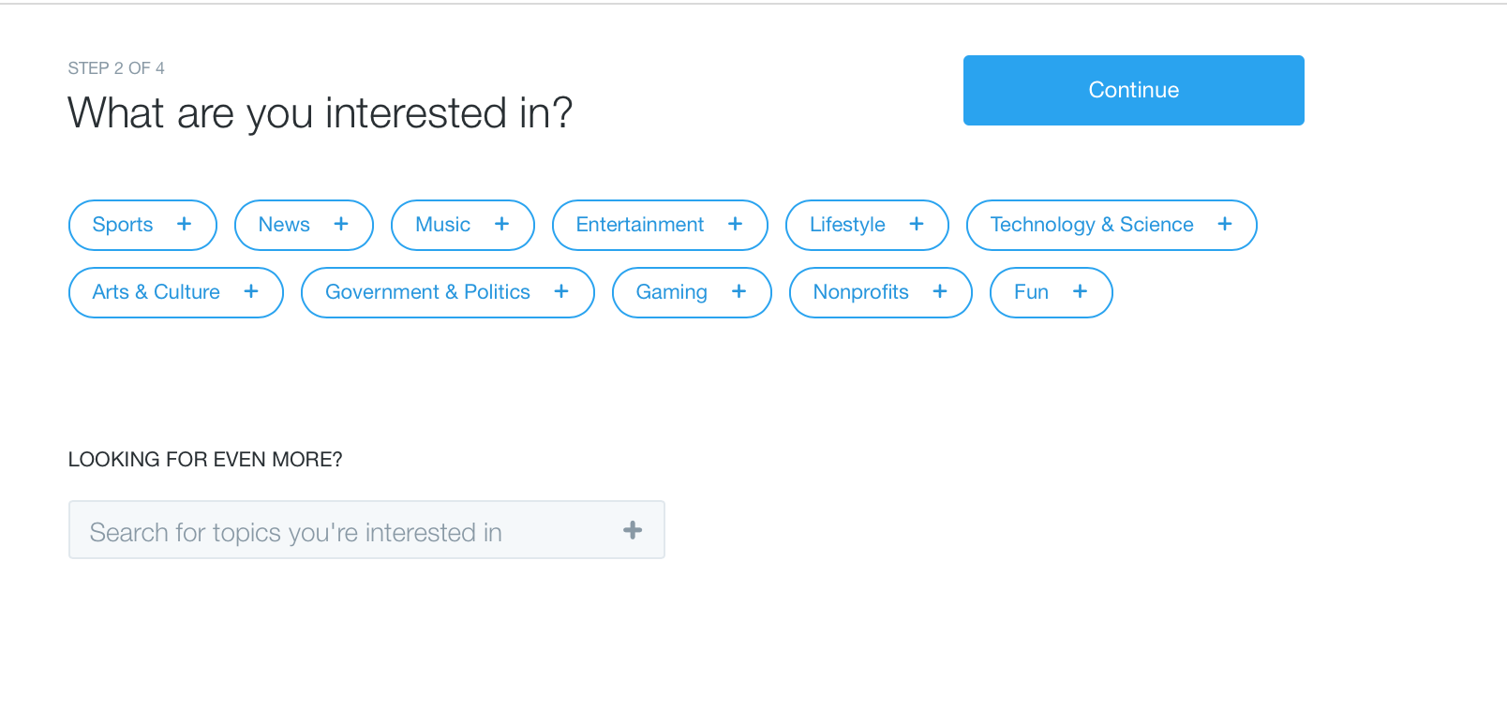
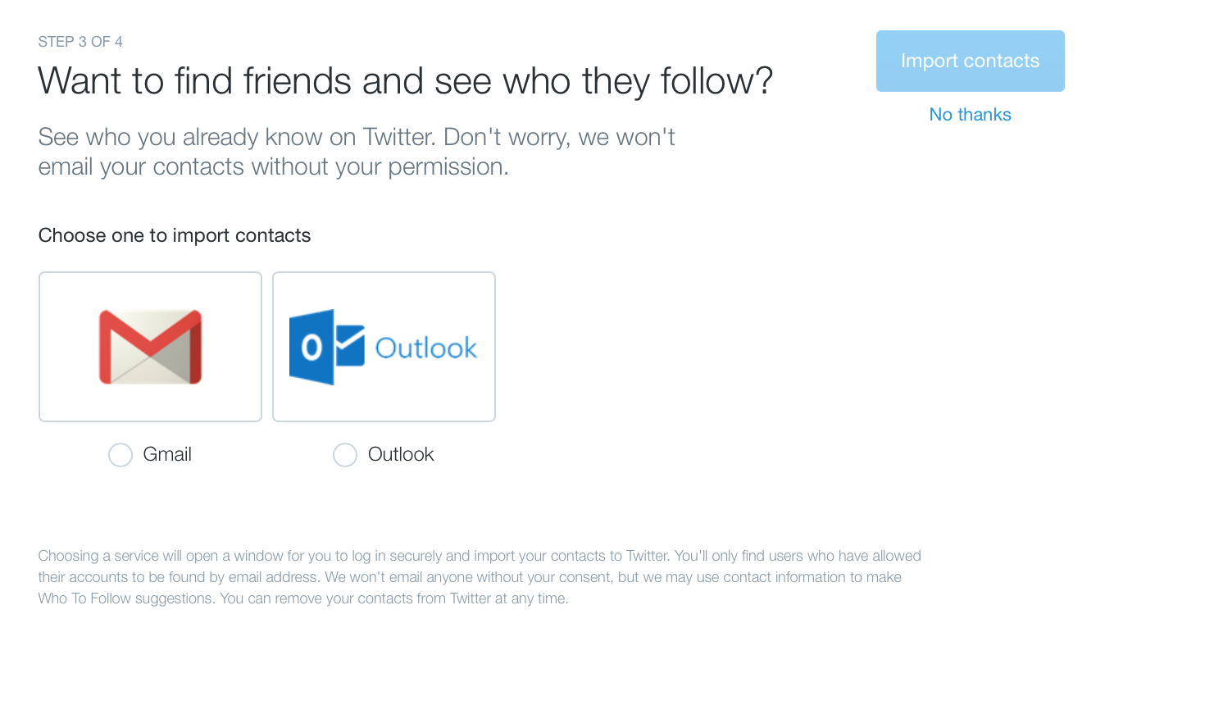
Get started:
Twitter.com/signup
Share interests
Create a handle
Find people you know

Slide 8

Optimize

Slide 9
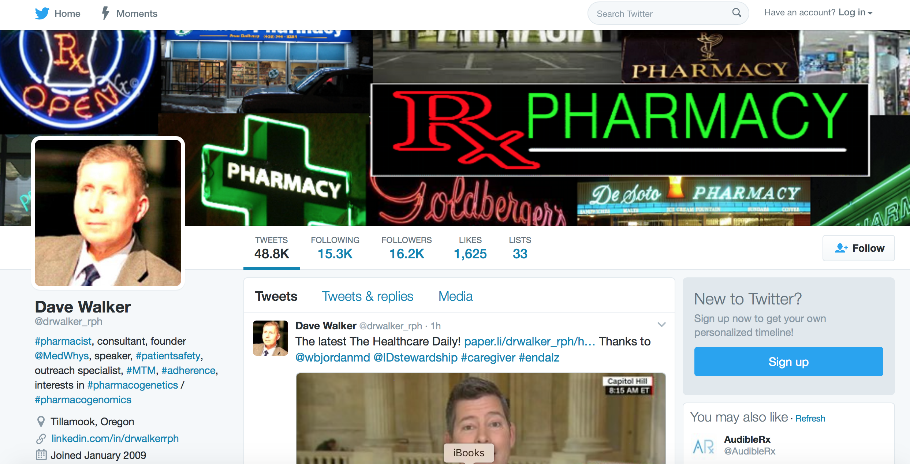
Complete your profile:
Banner image
Professional picture
Profile with keywords
Link to a digital asset

Slide 10

Network

Slide 11

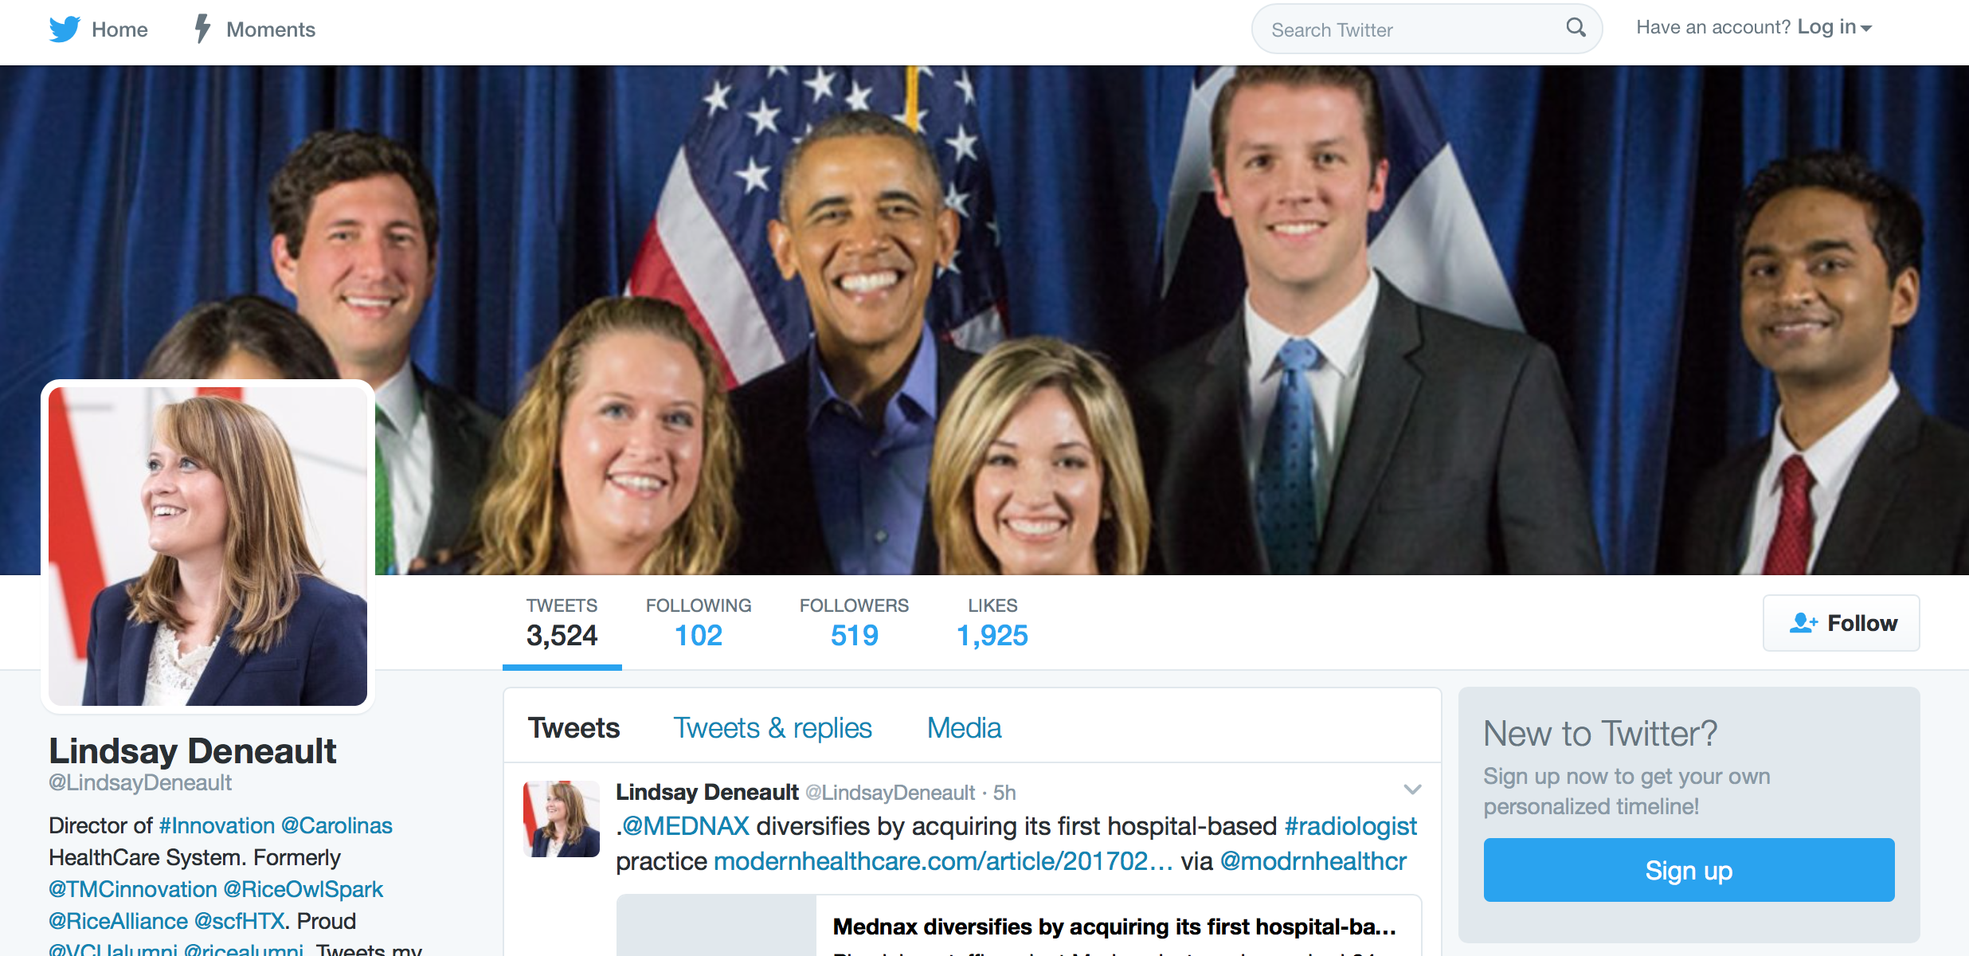
Follow thought leaders and brands
Search for topics using #s
Browse results
Follow

Slide 12
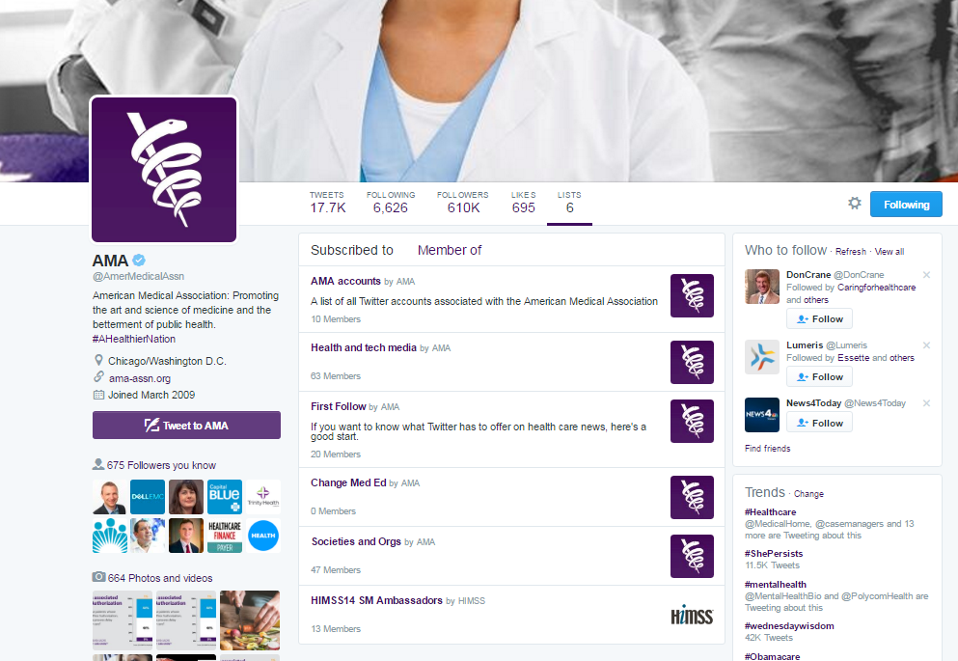
Follow lists
A list is a curated group of Twitter accounts
Find lists by looking through the profiles of influencers
Subscribe to lists that interest you

Slide 13

Engage

Slide 14
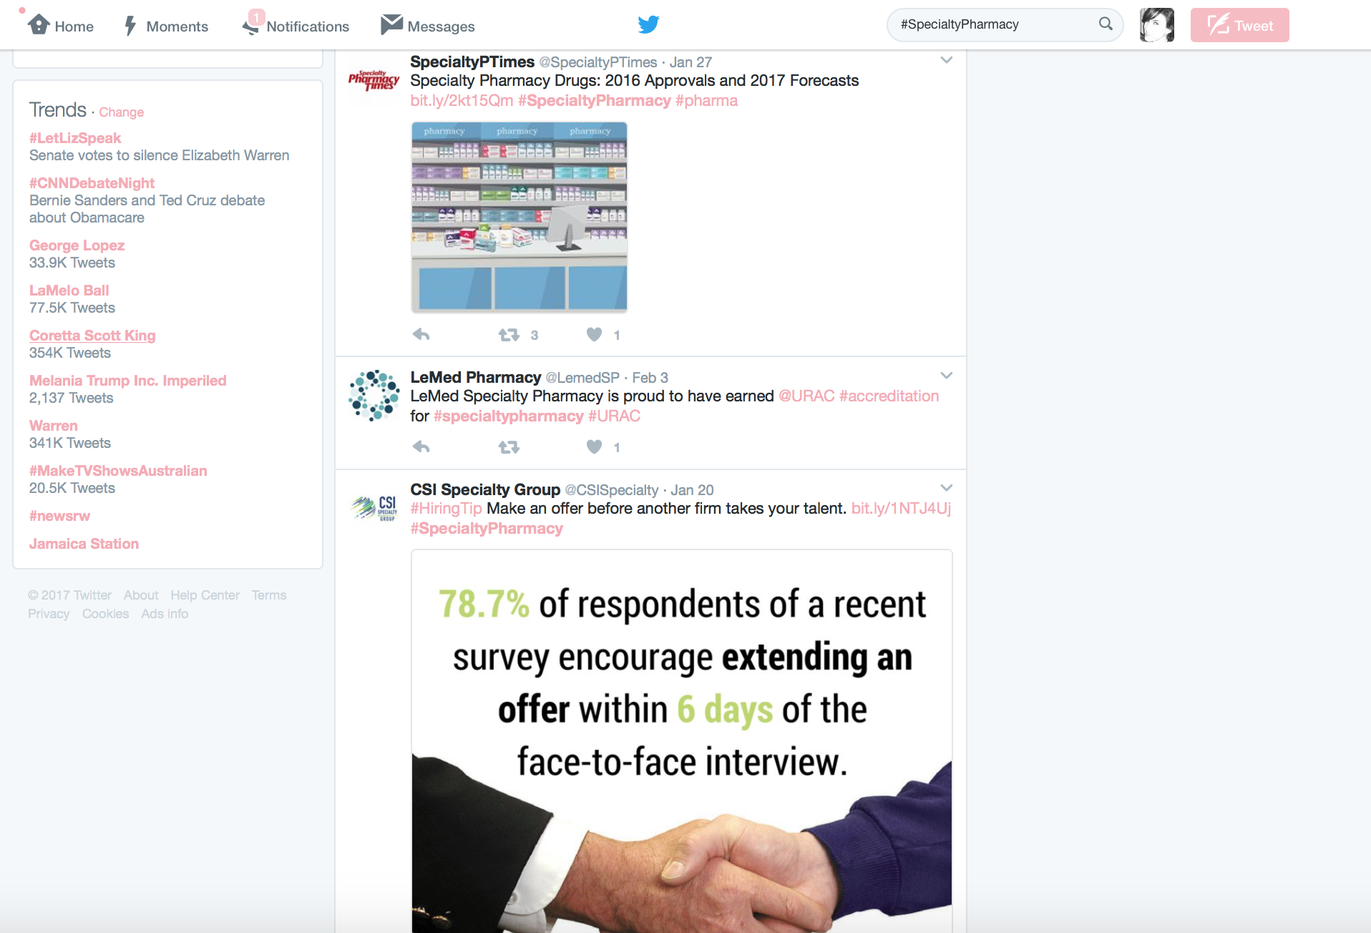
Browse your feed and search for #s
Search #s
Browse feed

Slide 15
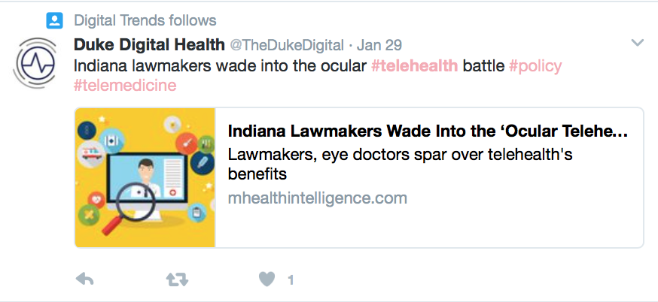
Engage with content by replying to, liking and retweeting tweets
Reply to
Like
Retweet

Slide 16
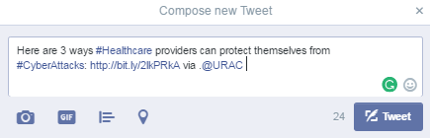
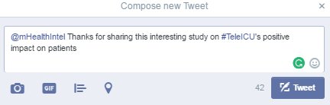
Start a conversation by tweeting to followers and influencers
Public mention
Direct mention

Slide 17

The do’s and don'ts of Twitter
Do:
Keep it short
Tweet promotions
Share content from influencers
Use two to three #s
Spread tweets throughout the day
Don’t:
Engage just with your followers
Be a robot – use your own voice
Oversell URAC
Overuse #s
Spam

Slide 18

To social media in 20 mins or less
Log in daily
Follow one person per day
Comment and share three times per week
Thank those who have interacted with your content or mentioned you
Respond to direct messages
Like two pieces of content daily
Soon it will become a habit, and your influence — will grow

Slide 19
Additional Resources
25 Twitter Do's and Don'ts for Businesses
  Text link: http://bit.ly/2bidOzL

Slide 20
Questions?

Slide 21

LinkedIn

Slide 22
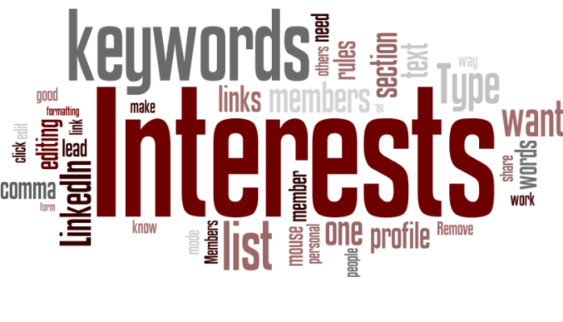
What is LinkedIn?
LinkedIn is a social networking site designed specifically for the business community.
Key Terms:
Profile: This is your personal account on the platform
Connections: Your professional network
Groups: Professional groups based around specific topics
Companies: Business entities

Slide 23

Optimize
Notes:
Credit: Ring Central https://www.ringcentral.com/blog/2015/05/5-tips-for-leveraging-linkedin-analytics-friday-five/

Slide 24
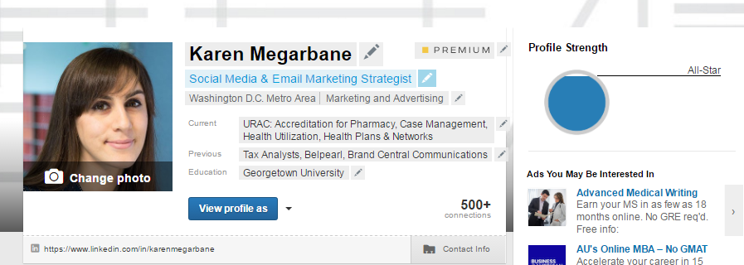
Complete your profile

Slide 25
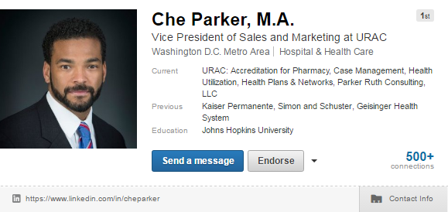
Optimize your header
Professional image
Strong headline
Link to contact information and digital assets
Vanity link
Notes:
A Professional Profile Photo (Headshot)
A Concise, Impactful Profile Headline

Slide 26
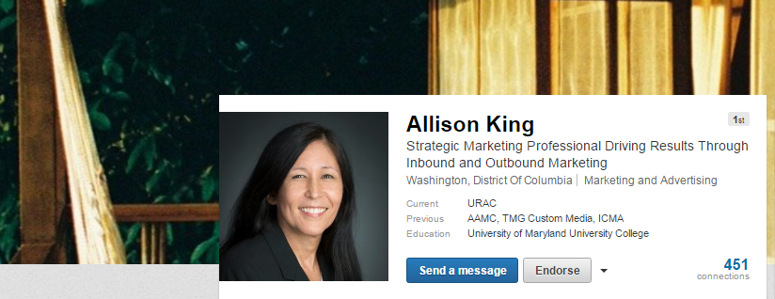
Turn your headline into a value proposition
Emphasize keywords to boost your visibility

Slide 27
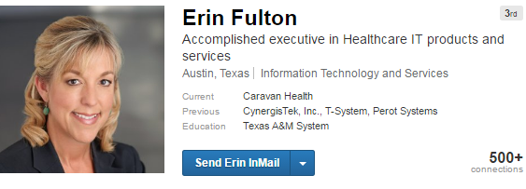
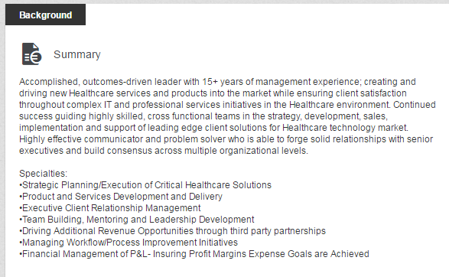
Write a summary full of keywords
Notes:
COO Caravan Health

Slide 28
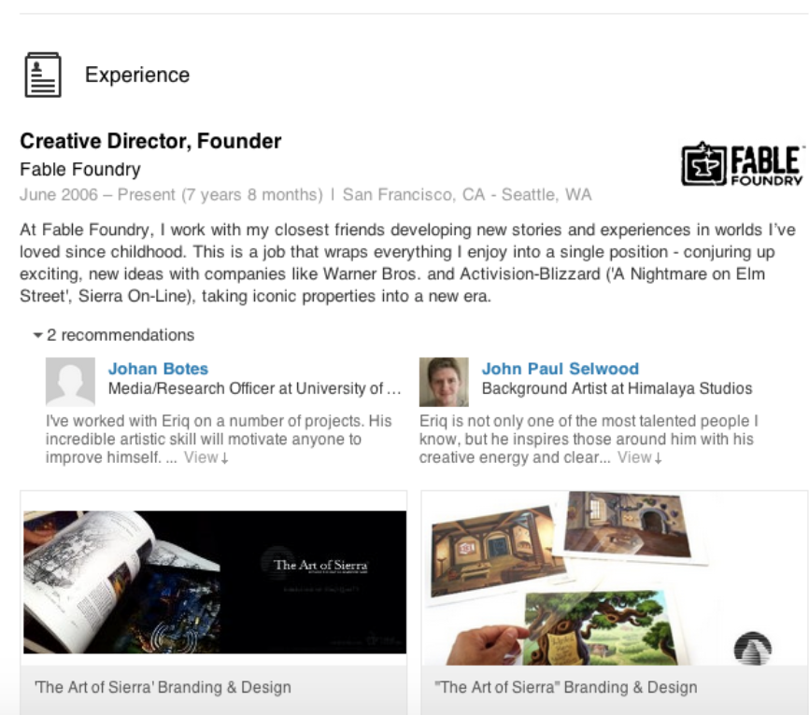
Enhance your experience with visual samples
Notes:
Write three paragraphs with three or fewer sentences about yourself. State your value proposition in the first line and provide proof of how you help clients attain goals in the second paragraph.

Slide 29
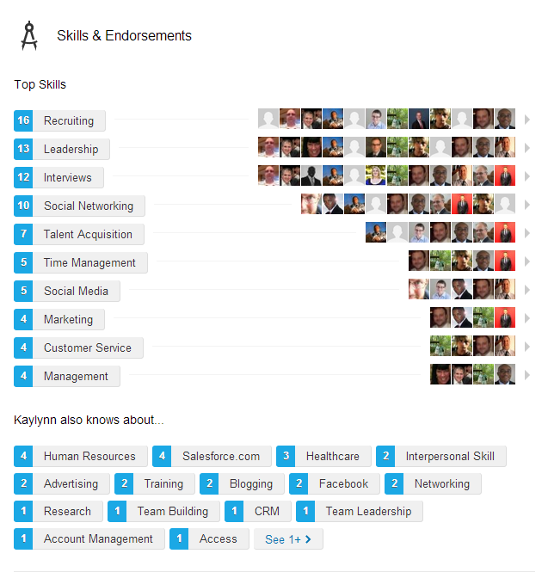
Reorganize and prioritize your skills
Notes:
Seek recommendations from customers to increase your credibility.
Build your skills section. Endorse other people in your network to encourage them to endorse you in return. Rearrange your skills place emphasize on those that focus on your ability to solve customer problems.

Slide 30
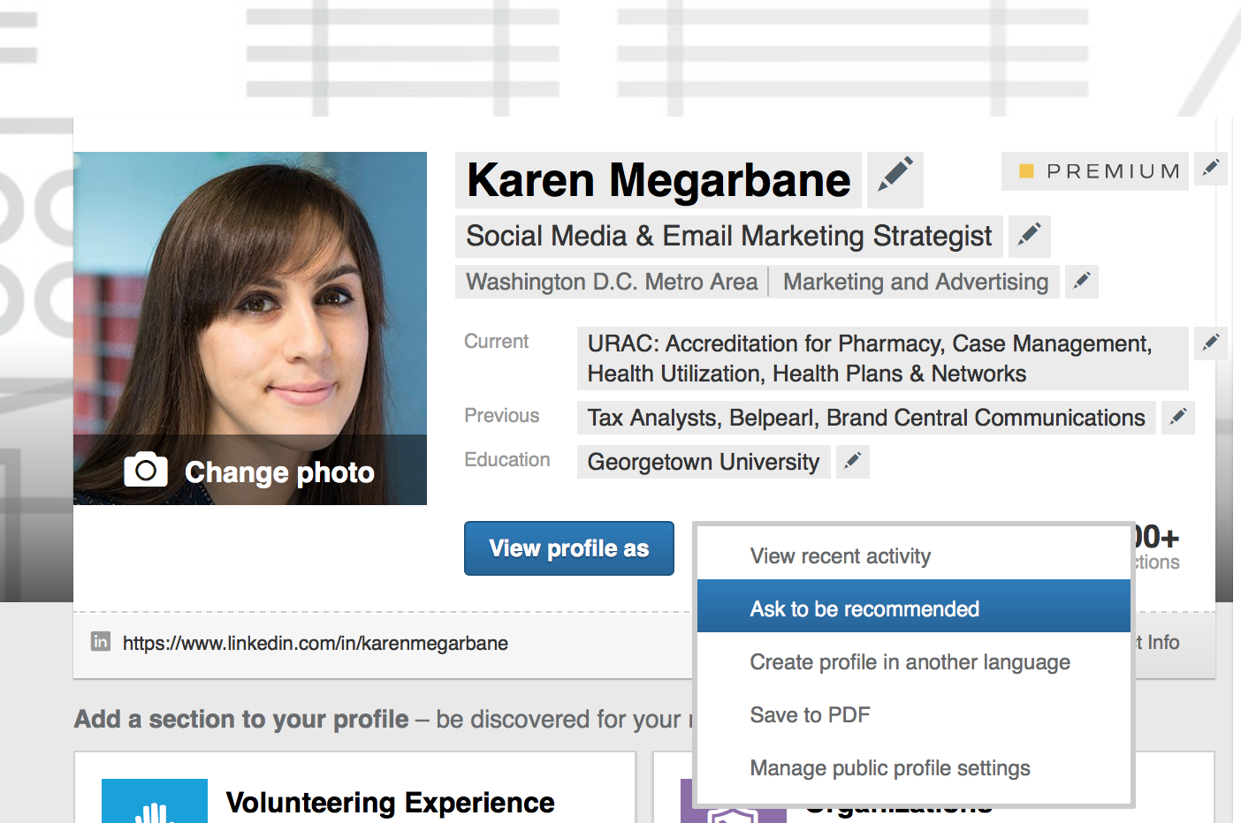
Increase your recommendations
Ask others to recommend you

Slide 31
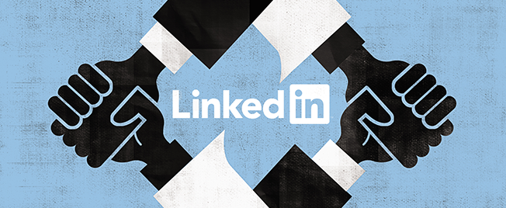
Network
Notes:
A Well Constructed List of Professional Experience
Skills and endorsements and projects

Slide 32
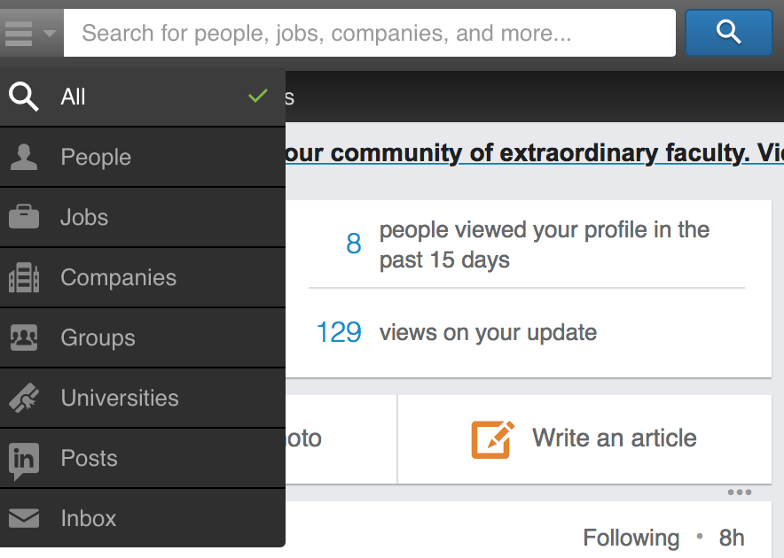
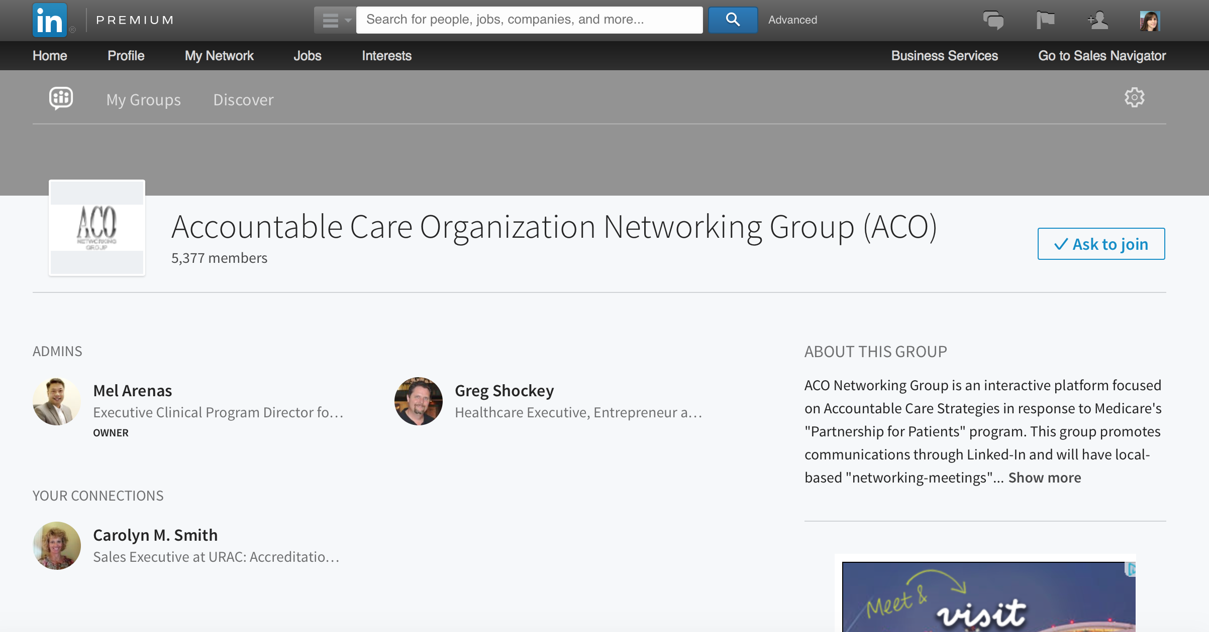
Connect with professionals, join groups, and follow companies
Search for keywords
Select groups that interest you
Request membership

Slide 33

Engage
Notes:
A Well Constructed List of Professional Experience
Skills and endorsements and projects

Slide 34
Engage through thought leadership
Join the conversation
Like and comment on content
Share content you read with connections
Contribute to a group discussion
Share content from The URAC Report and URAC website

Slide 35

The do’s and don'ts of LinkedIn
Do:
Personalize connection and recommendation requests
Turn off notifications when updating your profile
Send a thank you message that provides value
Introduce your connections to each other
Don’t:
Don’t treat LinkedIn like other channels
Don’t over post
Don’t criticize in groups
Do not post self-serving content in groups

Slide 36
Additional Resources
LinkedIn Etiquette: 20 Do’s & Don’ts
  Text link: http://bit.ly/18h72s5

Slide 37
Questions?

